Slide 1
FPGA Hardware Implementation of the Yolo Subclass Convolutional Neural Network Model in Computer Vision Systems 2022
Reporter:B10915061 詹宗叡

Slide 2
OUTLINE
I. INTRODUCTION
II. Related Work
III. FPGA Hardware Design and Optimization
IV. Experimental Results and Analysis
V. Applications and Future Perspectives

Slide 3
I. INTRODUCTION
Research Background
Application of Yolo Subclass CNN Model

Slide 4
1. Research Background
Discussing the significance of FPGA in computer and robot vision systems, emphasizing its role in enhancing computational speed and reducing power consumption.

Slide 5
2. Application of Yolo Subclass Convolutional Neural Network Model
Exploring the potential applications of the Yolo subclass model in robot vision tasks such as object detection and recognition.

Slide 6
II. Related Work
Summary of FPGA Applications in Computer Vision
Previous Research on Yolo Subclass Model

Slide 7
1. Summary of FPGA Applications in Computer Vision
Providing an overview of previous research in implementing computer vision algorithms on FPGA, particularly focusing on applications in robot vision tasks.

Slide 8
2. Previous Research on Yolo Subclass Model
Reviewing past research achievements and case studies concerning the Yolo subclass convolutional neural network model in computer and robot vision.

Slide 9
III. FPGA Hardware Design and Optimization
FPGA Architecture Design for Yolo Subclass Model
Hardware Optimization Strategies

Slide 10
1. FPGA Architecture Design for Yolo Subclass Model
Describing in detail the hardware architecture design required for implementing the Yolo subclass model on FPGA, including computation units and storage units.

Slide 11
2. Hardware Optimization Strategies
Discussing strategies and methods for optimizing FPGA hardware implementation, considering specific requirements of robot vision tasks, such as real-time processing and accuracy.

Slide 12
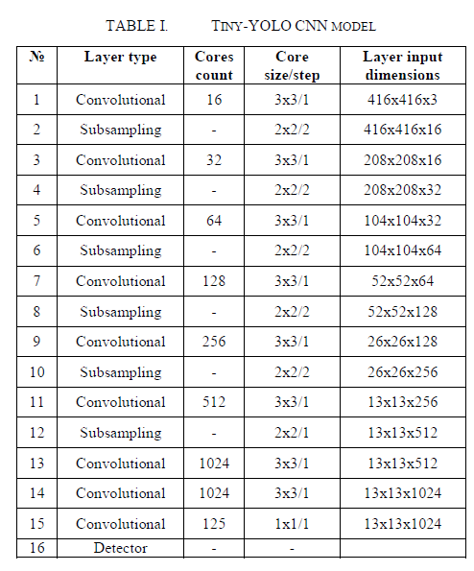
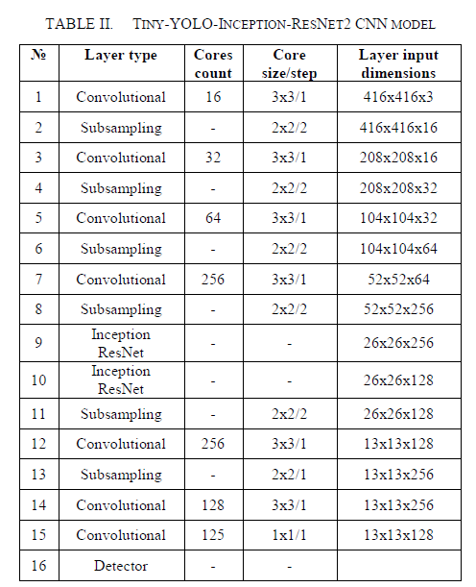
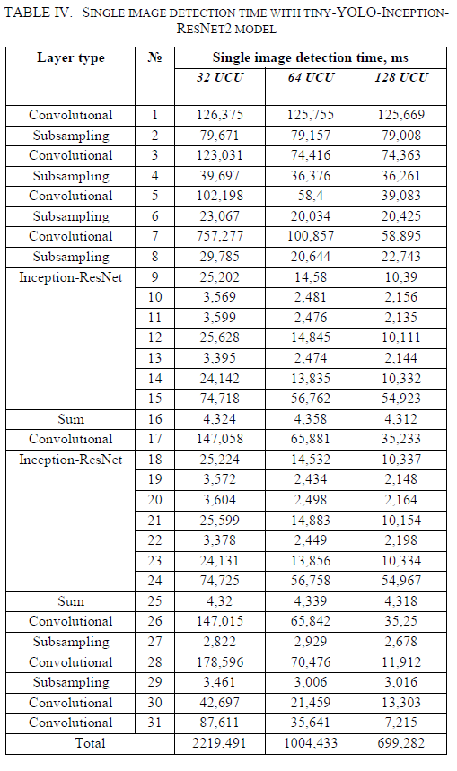
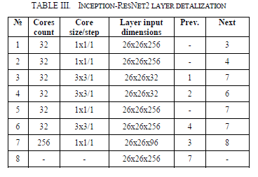
2. Hardware Optimization Strategies

Slide 13
IV. Experimental Results and Analysis
Performance Testing of Yolo Subclass Model on FPGA
Evaluation of Robot Vision Task Performance

Slide 14
1. Performance Testing of Yolo Subclass Model on FPGA
Reporting performance test results of implementing the Yolo subclass
convolutional neural network model on FPGA, including evaluations
of speed, accuracy, and power consumption

Slide 15
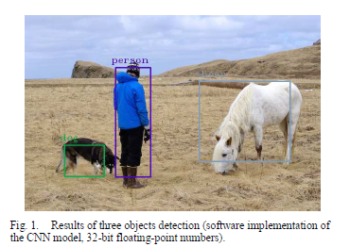
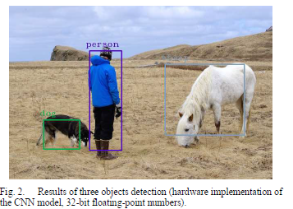
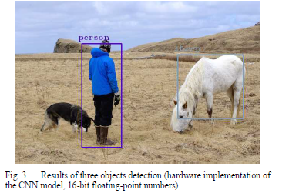
2. Evaluation of Robot Vision Task Performance
Analyzing the performance of applying the FPGA-implemented Yolo subclass model to robot vision tasks, such as intelligent navigation and object recognition

Slide 16
V. Applications and Future Perspectives
Analysis of Robot Vision System Application Scenarios
Future Research Directions

Slide 17
1. Analysis of Robot Vision System Application Scenarios
Analyzing application scenarios of implementing the FPGA-based Yolo subclass convolutional neural network model in real-world robot vision tasks, discussing its potential applications in intelligent robotics and autonomous navigation systems.

Slide 18
2. Future Research Directions
Proposing future research and development directions, including more precise hardware optimization strategies and exploring a wider range of application scenarios.

